Slide 1








Rapid ecosystem services assessment tools: a user-based categorization
Jean Hugé, Anne-Julie Rochette, Luc Janssens de Bisthoven, Jean-Didier Akpona, Bruno Verbist, Koen Vanderhaegen, Steven Van Passel
ESP, Togo, June 2019

Slide 2
Why assess ecosystem services?
Biosphere reserves provide a range of ecosystem services that are key to human well-being.
If the ecosystem services-concept needs to support the sustainable management of Biosphere reserves, we need a systematic, robust and credible assessment of the state and trends of these ecosystem services.
Such an assessment will allow managers to evaluate threats endangering various ecosystem services, and to develop actions to counter negative trends.
It will also contribute to communicate the added value of Biosphere reserves.
Notes:
Ecosystems, if properly managed, yield a flow of services that are vital to humanity, including the production of goods (e.g., food), life support processes (e.g., water purification), and life fulfilling conditions (e.g., beauty, recreation opportunities), as well as the conservation of options (e.g., genetic diversity for future use). Despite its importance, this natural capital is poorly understood, scarcely monitored, and—in many cases—undergoing rapid degradation and depletion. To bring understanding of nature’s values into decisions, the Natural Capital Project is developing models that quantify and map the values of ecosystem services.

Slide 3
Threat categorization framework for ecosystem services (Maron et al., 2017)

Slide 4
How to translate the booming scientific interest for ecosystem services….
Costanza et al., 2017

Slide 5
…into sustainable management actions?
Bodin et al., 2017

Slide 6
There are tools to do this!
There are many tools and methods to ‘translate’ ecosystem services data into management-relevant actions and into insights for decision-makers and for the general public.
These tools often have different objectives :
  Data collection tools
  Visualisation tools
  Models (forecasting tools)
  Participatory tools
  Economic valuation tools
The requirements in terms of time, skills and scope of application range widely.

Slide 7
How to select the right tool(s)?
Despite the wealth of tools that have been developed, their application is often limited.
This can be due to unrealistic data requirements, to the lack of specialized skills and/or the lack of financial, human and time resources to apply these tools in the field, and/or to the inappropriate scope (mismatch between the users’ needs and what the tool can offer).
Which tools can be used to assess ecosystem services in Biosphere reserves?
What are the pros and cons of each tool?

Slide 8
The EVAMAB approach to ES tool assessment
Step 1: Longlist of tools
Step 2: Identification of user-generated criteria to assess tools
Step 3: Categorization of tools
Step 4: Field application of a selection of tools

Slide 9
Step 1: Longlist of tools to be assessed
Selection criteria:
Generalizable
Applicable at the landscape scale
Applicable independently (i.e. without a priori requiring external expertise)
Affordable (i.e. without requiring a priori financial investment)
Able to assess multiple ecosystem services
Rapid (i.e. requiring less than a year to apply the tool)

Slide 10
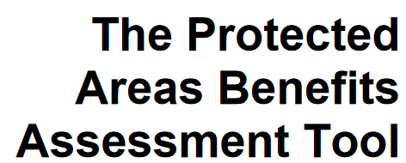










Step 1: Longlist of tools to be assessed
→ 19 tools selected
Co$ting Nature
GEOMOD
A Geographic Information Systems-based LUC change model
SITE framework (SImulation of Terrestrial Environments)
ARIES - ARtificial Intelligence for Ecosystem Services
Ecosystem Services Review
Ecosystem Services Review for Impact Assessment
Interdisciplinary Decision Support Dashboard (IDSD)
Social Values for Ecosystem Services (SolVES)
Green Infrastructure Valuation Toolkit

Slide 11

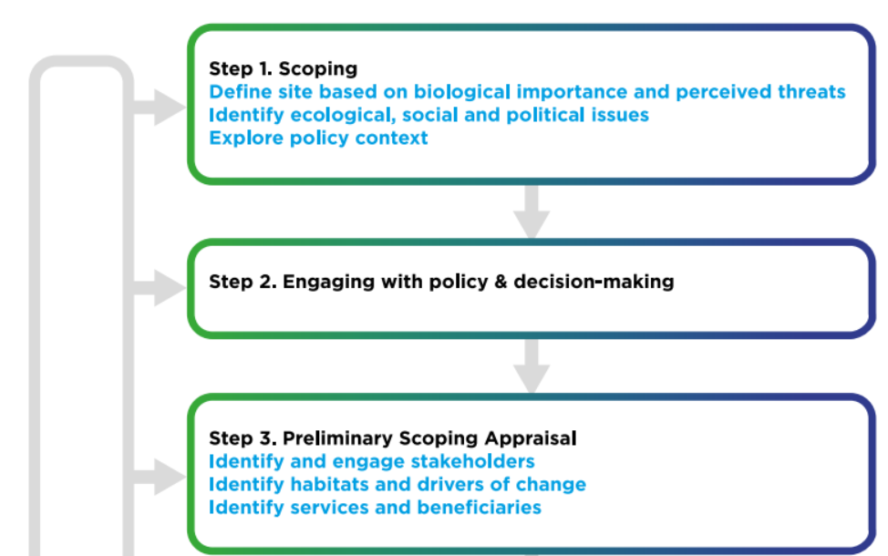
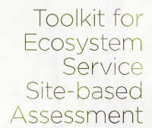
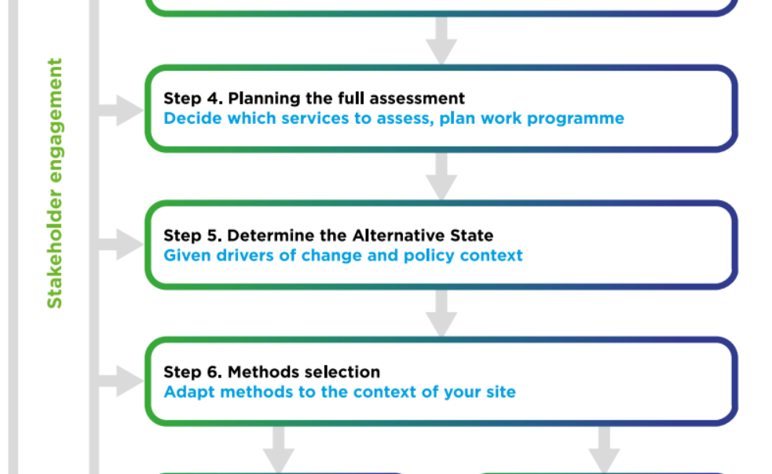
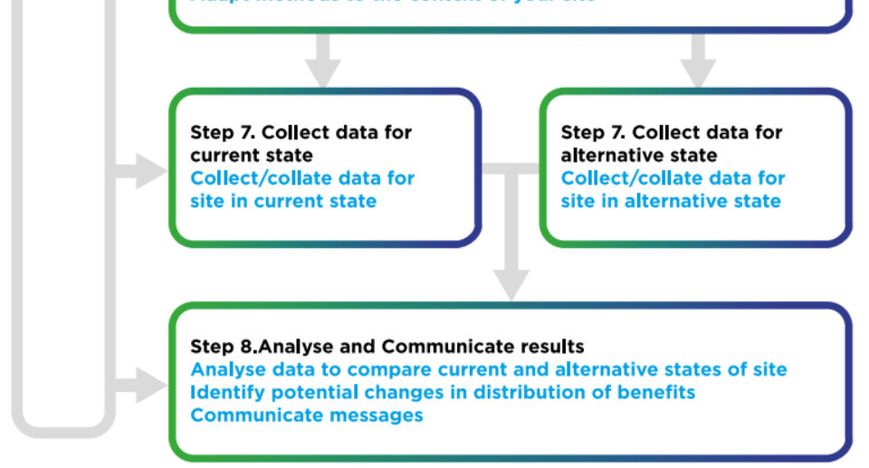
Examples:
Purpose: Prioritization, quantification and monetary estimation of ES; Comparing current situation with a most likely state of the site
Time: days→ months
Inputs: Stakeholder-based input; Available data; Field sampling
Skills: Stakeholder involvement
Outputs: Quantitative data; Qualitative data; Economic valuation
ES: Regulating: climate regulation, flood protection, water quality improvement; Provisioning: harvested wild and cultivated goods, water provision; Cultural: nature-based recreation

Slide 12
Step 2: Identification of user-generated criteria to assess the tools
Synthesis of criteria proposed in the scientific literature
Validation & identification of additional criteria by way of a Delphi survey among experts present at AfriMAB 2017
Delphi is an iterative survey which allows participants to air their opinion (round 1), and to possibly modify their initial opinion in round 2, after having been exposed to anonymized responses of their peers.
Delphi allows to identify criteria for which there is consensus or not.

Slide 14
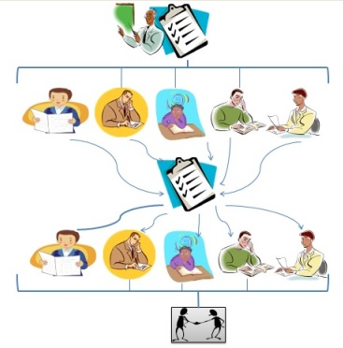

Slide 15
Delphi: profile of the participants

Slide 17
Step 3: Categorization of tools

Slide 18
Step 3: Categorization of tools based on required input

Slide 19
Step 3: Categorization of tools based on required skills

Slide 20
Step 3: Categorization of tools based on generated output

Slide 21
Step 3: Categorization of tools based on the ecosystem services addressed

Slide 22
Step 4: Application of tools in the field
Case study locations of EVAMAB (Benin, Ethiopia, Tanzania, Uganda) plus additional applications in Senegal, Kenya and the Republic of Congo
Modification of existing tools (e.g. TESSA-inspired Nominal Group Technique)
Application of complementary methods, such as judgement elicitation methods (e.g. Q methodology to map stakeholders’ perceptions)

Slide 23
From tools to decision-making
Ruckelshaus et al., 2015

Slide 24
Concluding reflections
The diversity of available tools is a plus, but can also be overwhelming: which tool should one select?
The EVAMAB approach allows to motivate tool selection, and is validated by experts-potential users.
The practical application of tools, and the experimentation with hybrid methods allows to adapt and fine-tune existing methods, as challenges and methods keep evolving.
How to anchor ecosystem services into decision-making regarding Biopshere reserves?

Slide 25
Contact
Anne-Julie Rochette
CEBioS, Royal Belgian Institute of Natural Sciences (RBINS)
ajrochette@naturalsciences.be
Prof. Dr. Jean Hugé
Université Libre de Bruxelles (Systems Ecology & Resource Management)
CEBioS, Royal Belgian Institute of Natural Sciences (RBINS)
Hasselt University (Centre for Environmental Sciences)
Vrije Universiteit Brussel (Biology Department)
Jean.Huge@ulb.ac.be

Slide 26
References
Bagstad et al. 2013. A comparative assessment of decision-support tools for ecosystem services quantification and valuation. Ecosystem Services 5: e27-e39.
Bodin et al. 2017. Collaborative environmental governance: achieving collective action in social-ecological systems. Science 357 (659)
Costanza et al. 2017. Twenty years of ecosystem services: how fare have e come and how fare do we still need to go? Ecosystem Services 28: 1-16.
Guerry et al. 2012. Modeling benefits from nature: Using ecosystem services to inform coastal and marine spatial planning. International Journal of Biodiversity Science, Ecosystem Services & Management 8:107-121
Hugé et al. 2018. Critical evaluation of rapid ecosystem services assessment tools in African Man & Biosphere reserves. Poster presented at the IUCN-conference ‘Communities, Conservation & Livelihoods’. Halifx, Canada, June 2018.
Hugé, Rochette et al. In review. Ecosystem services assessment tools for African Biosphere Reserves: a user-based categorization. Ecosystem Services in review.
IUCN 2018. Tools for measuring, modeling and valuing ecosystem services. IUCN. Gland, Switzerland.
Maron et al. 2017. Towards a threat assessment framework for ecosystem services. Trends in Ecology & Evolution 32: 240-248.
Mukherjee et al. 2018. Comparison of techniques for eliciting views & judgements in decision-making. Methods in Ecology & Evolution
Ruckelshaus et al. 2015. Notes from the field: lessons learned from using ecosystem services approaches to inform real-world decisions. Ecological Economics 115: 11-21.

