Slide 1
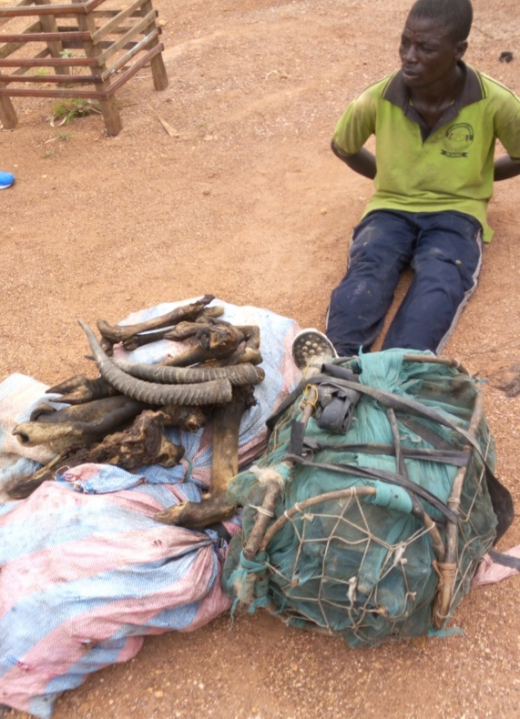
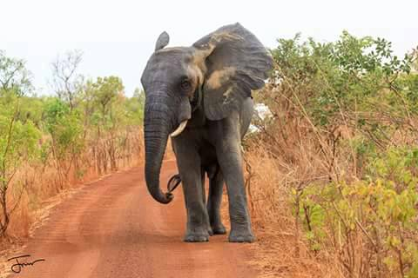
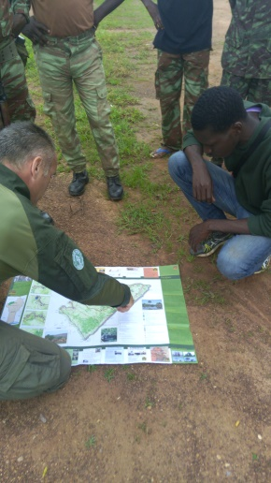
Poaching status, and its spatial impacts within Pendjari Biosphere Reserve (Northern Benin)
MSc. Galvius Finagnon DEGBELO
Laboratory of Applied Ecology(LEA)
Faculty of Agronomic Sciences (FSA)
University of Abomey-Calavi (Bénin)

Slide 2
Outline
Introduction
Study area
Methods & Results
Conclusion & Suggestions

Slide 3
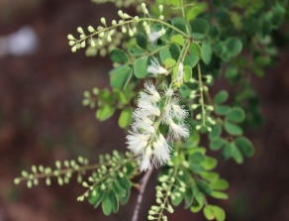
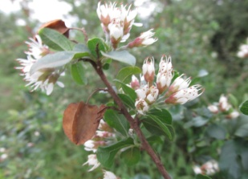
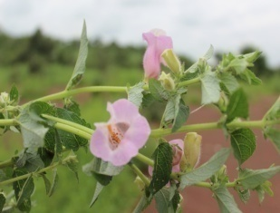
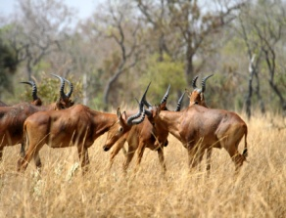
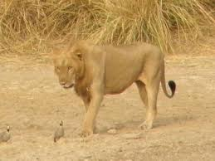
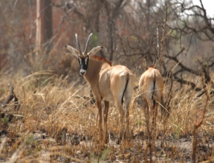
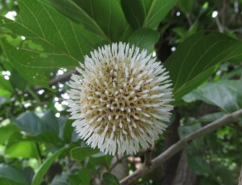
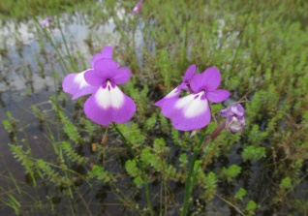
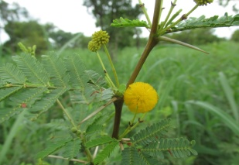
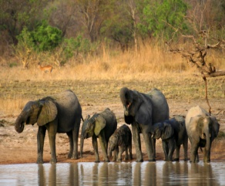
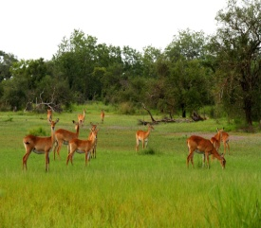
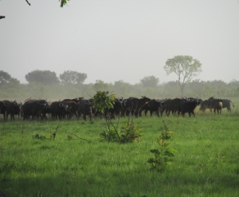
Introduction
The Pendjari Biosphere Reserve is one of the best protected areas in West Africa.
Flora
Fauna
25% of Benin Flora
Elephant: 1719 Individuals (2015)
Buffalo 6619 Individuals (2015)
Lion ± 100 Individuals (2013)
This high species diversity attracts many tourists but unfortunately many poachers.

Slide 4
Objectives
Global
Understand the drivers of poaching in the Pendjari Biosphere Reserve (PBR).
SO₁- Characterize poaching in the PBR.
SO₂- Map the poaching patterns of the top five poached wildlife species
SO₃- Assess anti-poaching technics implemented in PBR

Slide 5
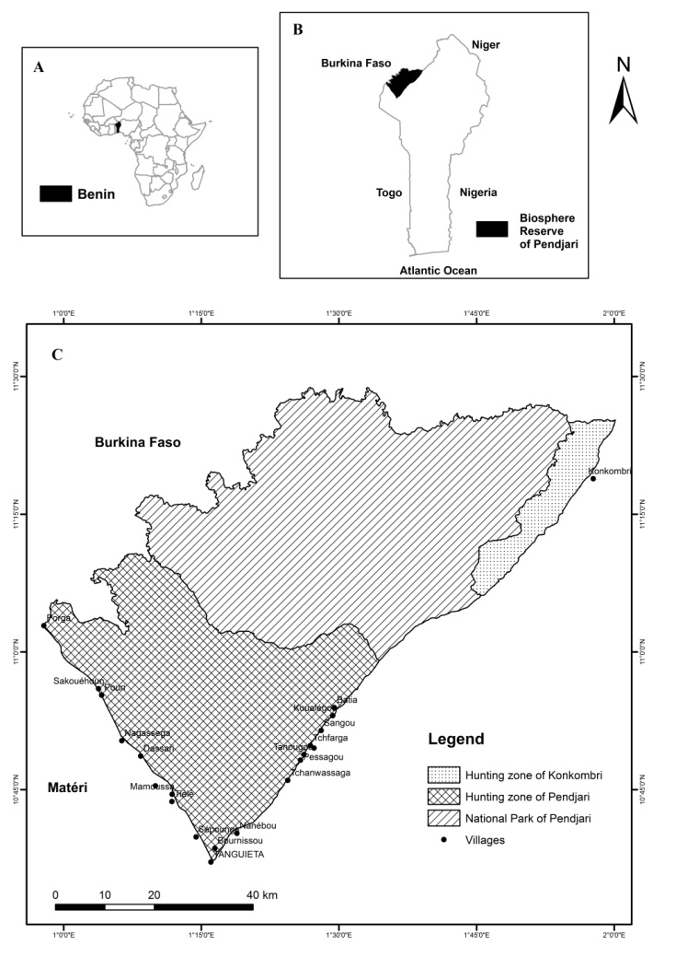
Study site
Location: 10°30’ to 11°30 N; 0°50’ to 2°00’ E
Climate: Tropical
Wet season: May to October
Dry season: November to March
Rainfall: 1,000 mm
(60%: July to September).
Temperature: 25°-32 °C
Figure 2 : Map of Pendjari Biosphere Reserve

Slide 6
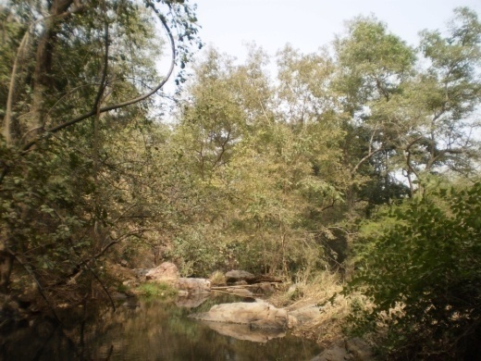
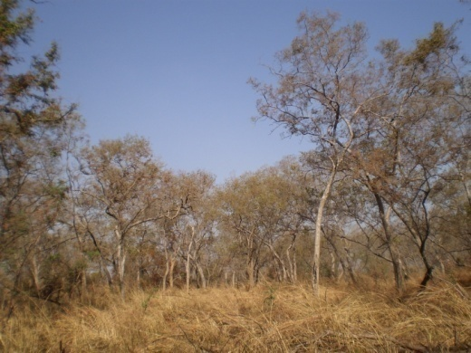
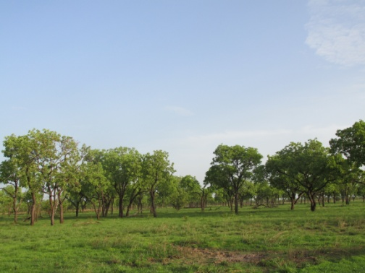
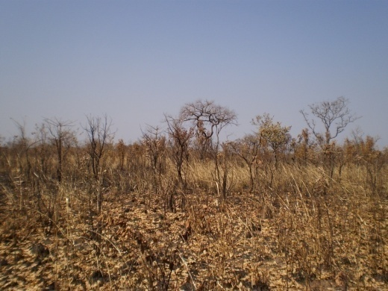
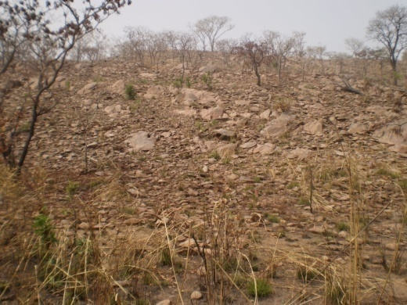
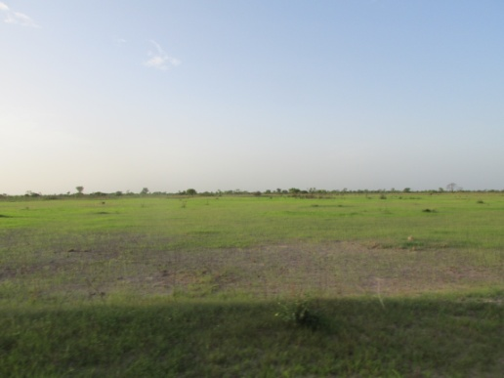
Study site
Vegetation types
Gallery forest
Woodland
Tree savanna
Shrub savanna
Outcrop savanna
Grass savanna

Slide 7
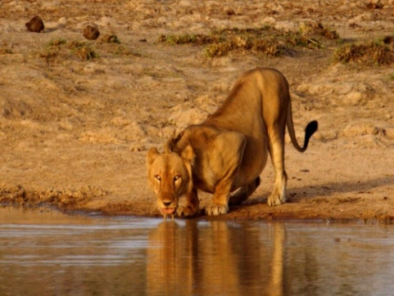
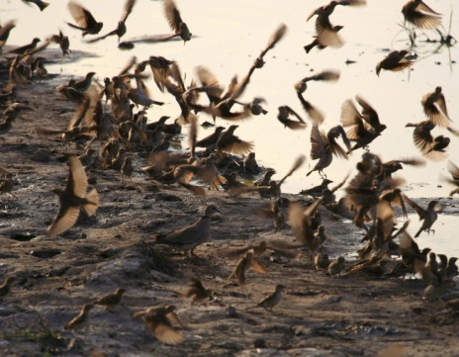
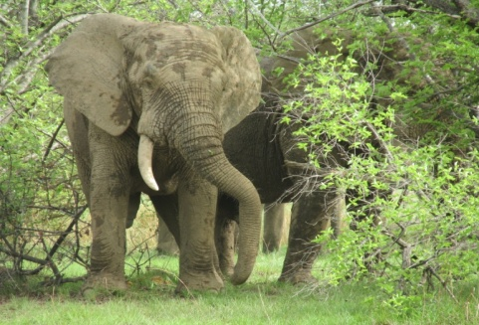
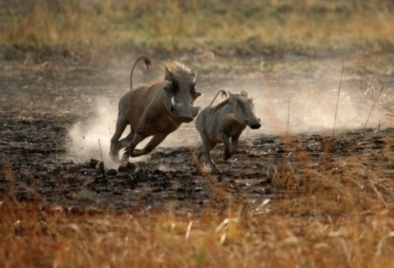
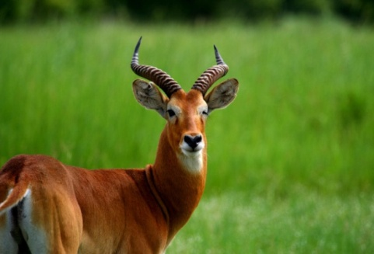
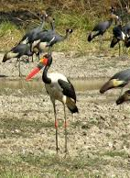
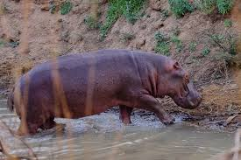
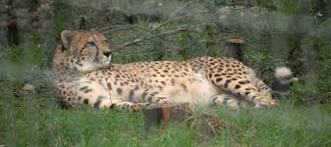
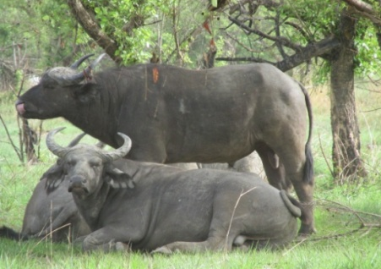
Study site
Fauna richness

Slide 8
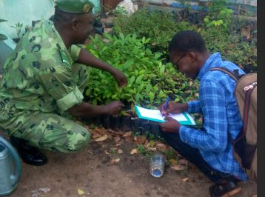
Poaching characteristics in PBR
Data collection
All available reports of patrol activities
Data analysis
(R Core Team, 2017)

Slide 9
Poaching characteristics in PBR
1- Number of poached animals per year
We found a decrease in the number of poached animals from 2011 to 2017.

Slide 10
Poaching characteristics in PBR
2- Poaching zone in the PBR
Poaching is much more in the National Park (Core area) versus more disturbed areas such as hunting zones and villages.

Slide 11
Poaching characteristics in PBR
3- Most poached species in the PBR
There is a positive correlation between species population size and the number of poached individuals
r = 0.624; p = 0.023

Slide 12
Poaching patterns Map of top five wildlife species
Data collection
Data on poaching locations from 2011 to 2017 have been collected
Data analysis

Slide 13
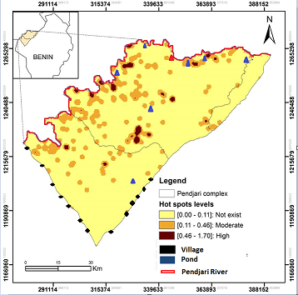
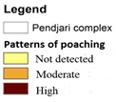
Poaching patterns map of top five wildlife species
Poaching is scarce near villages and concentrated along the Pendjari River.
Figure 3 : Wildlife poaching patterns in PBR

Slide 14
Poaching patterns map of top five wildlife species
Table 1. Results of the Generalized Linear Model on kernel values
Terms | Means(Km) | Estimate | SE | t value | p
Distance between poaching site and Park Gate | 22.51 | -0.01 | 0.04 | -0.17 | 0.869
Distance between poaching site and Waterholes | 14.45 | -0.01 | 0.01 | -2.03 | 0.047*
Distance between poaching site and Patrol Camp | 21.87 | 0.01 | 0.04 | 0.22 | 0.828
Distance between poaching site and Park Road | 19.99 | 0.00 | 0.00 | -0.32 | 0.749
Distance between poaching site and Pendjari River | 5.767 | -0.06 | 0.02 | -3.03 | 0.004**
Distance between poaching site and Reserve Boundary | 6.65 | 0.04 | 0.01 | 2.58 | 0.013*
Notes:
Using the R software, we carried out a generalized linear model on the kernel value to see the biophysical and human factors best predicting the poaching.
We find that poaching areas are more concentrated around the waterholes and along the Main River but far from the reserve boundaries.

Slide 15
Assess anti-poaching technics implemented in PBR
1- Anti-poaching technics practiced
The pedestrian patrol is the most practiced. Vehicles are used to bring rangers targeted areas.

Slide 16
Assess anti-poaching technics implemented in PBR
2- Patrol implementation
The routine patrol is the most used strategy. The search patrol is supported by intelligence information.

Slide 17
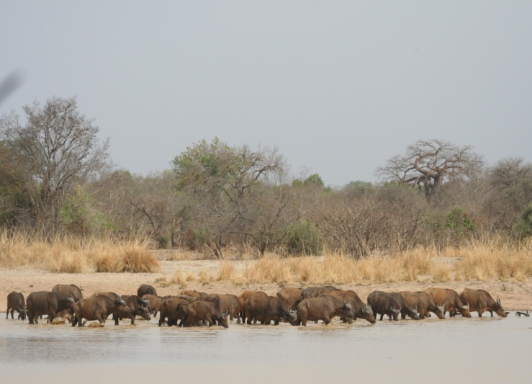
Conclusion & Suggestions
Two of the big five among the most poached species
Poaching occurs far from villages and mostly around ponds and the Pendjari River.
It’s important to put more focus on patrol around ponds and along the Pendjari River particularly in dry season.

Slide 18
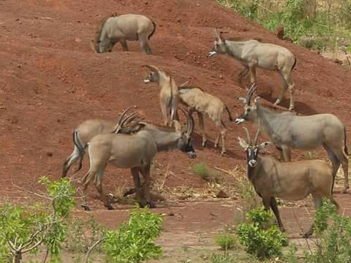
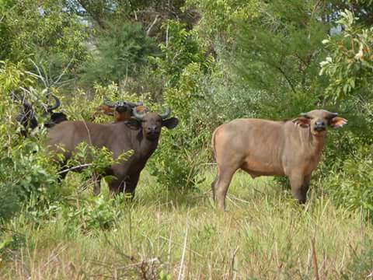
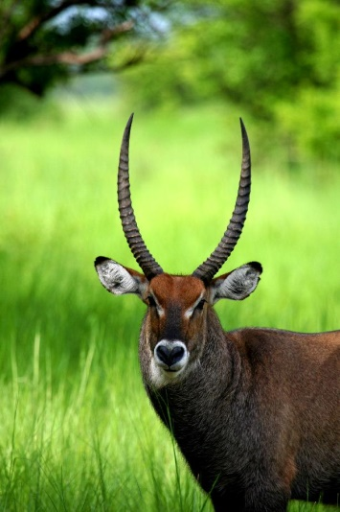
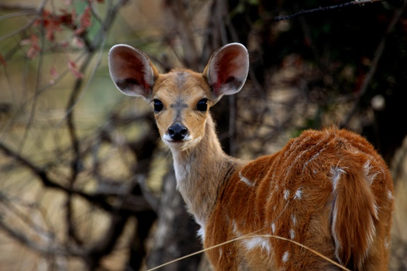
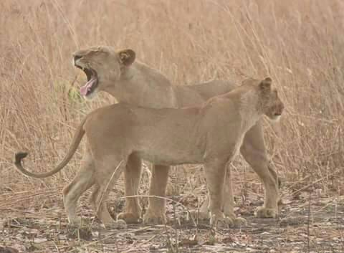
THANKS FOR YOUR ATTENTION

