Slide 1
Université de Parakou
FACULTE D’AGRONOMIE
Laboratoire d’Etudes et de Recherches Forestières (LERF)
EFFECT OF CUTTINGS DIAMETER AND INDOL ACETIC ACID ON THE ROOTING OF PTEROCARPUS ERINACEUS POIR. STEM CUTTINGS
Christine OUINSAVI, Bienvenue SOUROU,Towanou HOUETCHEGNON,
Appolinaire WEDJANGNON, Yanik Y. AKIN

Slide 2
Outline
Introduction
Objectives
Methodology
Results and discussions
Conclusion and perspectives

Slide 3
Introduction
Tropical forests 50% of organisms (plants, animals, fungi etc.),richest biodiversity on earth (Ninko and Hounkpossi, 2011).
Benin , west African faces imbalances of naturals ressurces , destruction accelerated (Ganglo and Maître, 2003).
Bush fires, land clearing for agriculture, firewood, or charcoal production destruction
In addition, Urbanization, Non timber forest product (edible fruit, medicinale, aromatic plants) (Segla et al., 2015).
100.000ha/ an of vegetation every year in Benin (FAO, 2016)

Slide 4
Introduction
Dissappearance of especies, Pterocarpus erinaceus leguminous Papilionoideae (super family), Fabaceae (Family)
Multipurpose Species endemic , Soudano-Guinean, et Soudano-Sahelean
Species, threatened by various practices, problem of regeneration (Glèlè et al.,2008, Rabiou et al., 2015)
Biology/ Sylviculture of species as measure, ensure biodiversity (Montesqui 2000, Ali et al., 2017)

Slide 5
Introduction
Rooting of Pterocarpus e. impossible, propagation stem cuttings (not possible) (Kouami, 2015, Bodjrenou et al. 2018)
Reinforce knowledge, sylviculture of species
Determine , effect of class diameter of cuttings , doses of AIA on budding, buds bursting, rooting

Slide 6
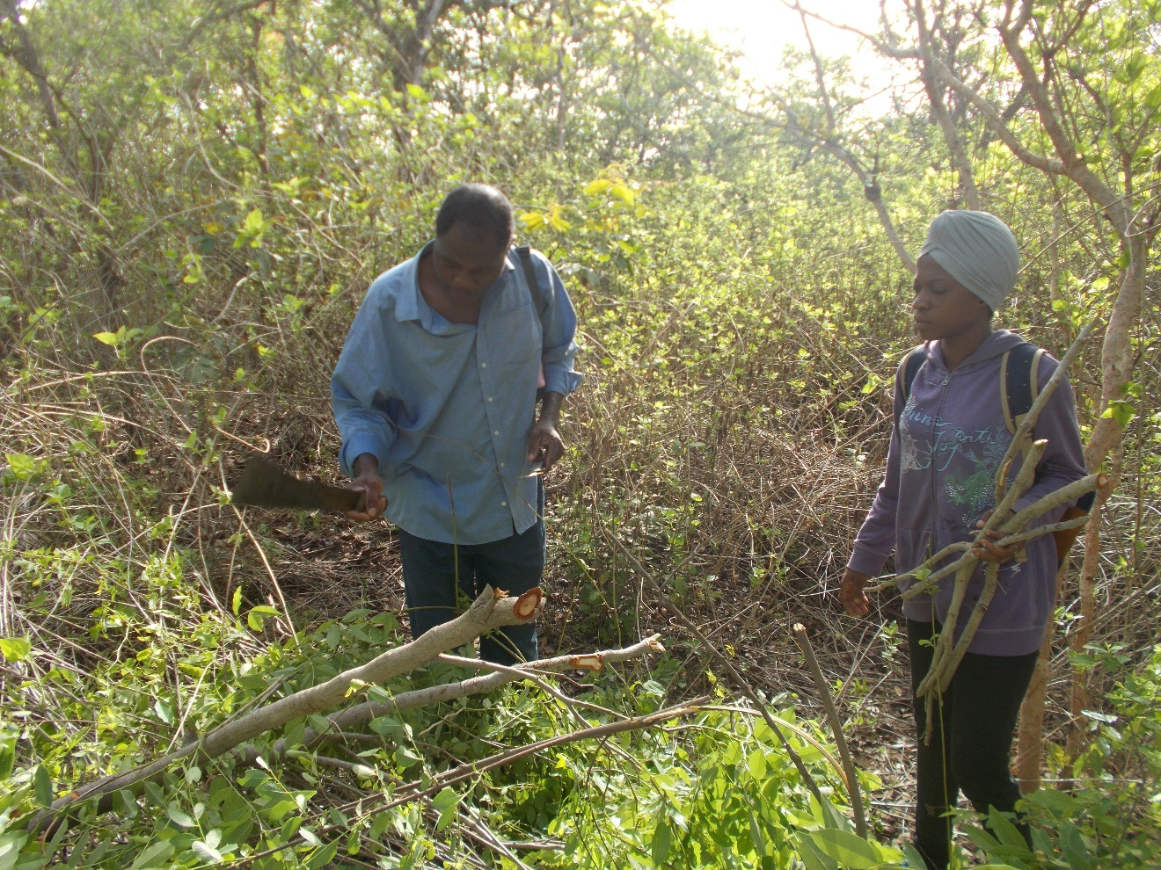
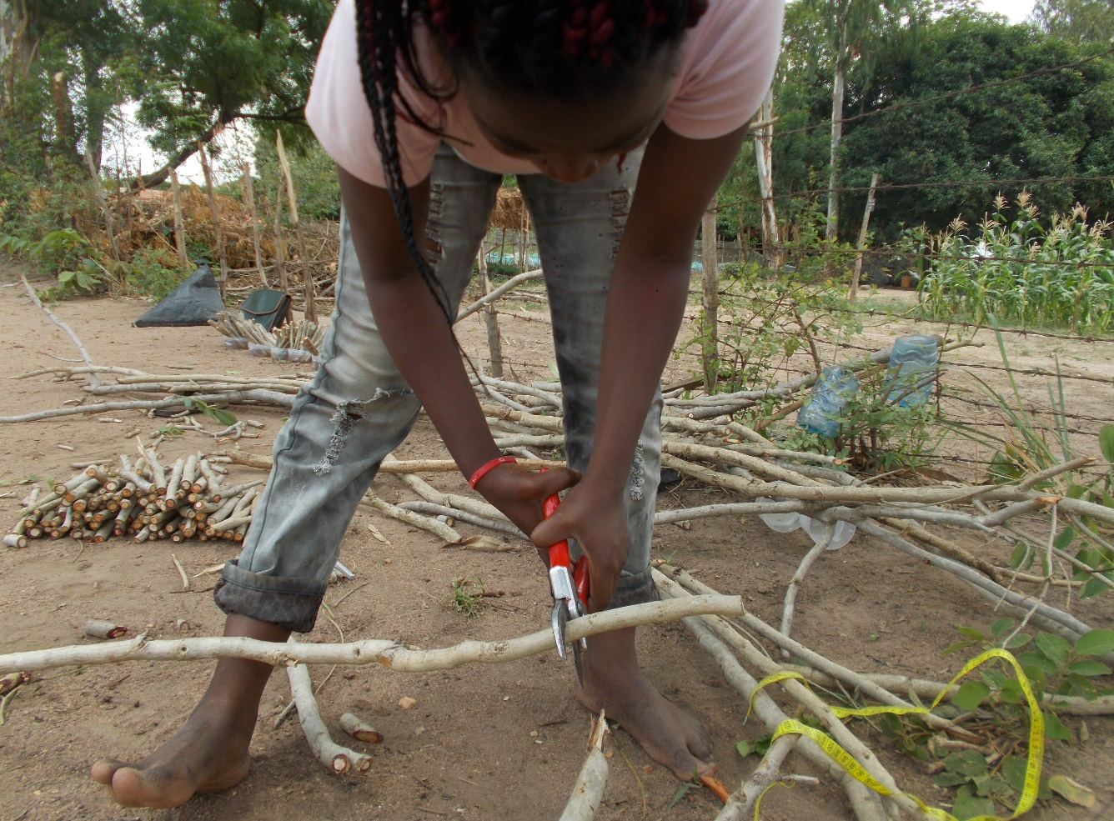
Methodology
Materials : P. erinaceus , Ouémé-Supérieur in northern Benin.
Figure 1: Cuttings harvested Figure2: Cutting of cuttings

Slide 7
Methodology Materials
Figure 3 : Doses of AIA for solutions for cuttings soakingJ
Figure 4 : Soaking of cuttings on differents doses of AIA

Slide 8
Methodology
Experiment design: Split plot, Diameter of cuttings ([2 - 2.5], [2.6 - 3] and [3.1 - 3.5] cm), Doses of AIA (750; 1500; 2000 mg/l), Time of soaking (10s; 20min and 1 hr). 432 treatments, repetition (3 times)
Data collected: Number of cutings burded, burd bersted, rooted
Data analysis : (glm, binomial), packages (effects) (oods ratio, Probability)

Slide 9
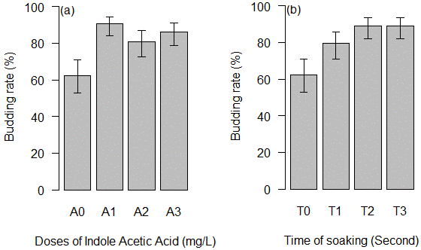
Results and discussions
Budding
Table1: Results of glm on budding
Treatments | Odds Ratio | STD | P>|z|
Indole acetic acid dose (mg/l)
750 | 5.70 | 1.95 | 0.000
1500 | 2.55 | 0.72 | 0.001
2000 | 3.71 | 1.13 | 0.000
Soaking time (seconds)
10 | 2.32 | 0.64 | 0.002
1200 | 4.86 | 1.59 | 0.000
3600 | 4.86 | 1.59 | 0.000
Figure 5 : Budding rate according to AIA doses and duration of soaking
Bodjrenou et al. (2018) on P, erinaceus stem cuttings (35.5%) (NAA)

Slide 10
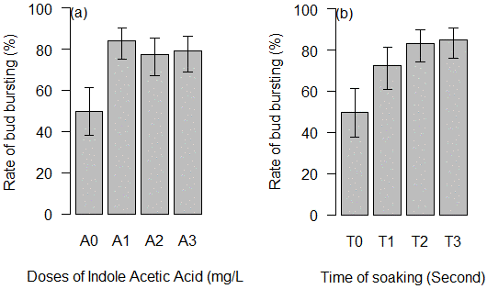
Results and discussions
Burd bursting
Table1: Results of glm on burd bursting
Treatments | Odds Ratio | STD | P>|z|
Indole acetic acid dose (mg/l)
750 | 5.21 | 1.51 | 0.000
1500 | 3.40 | 0.91 | 0.000
2000 | 3.71 | 1.01 | 0.000
Soaking time (seconds)
10 | 2.59 | 0.67 | 0.000
1200 | 4.94 | 1.42 | 0.000
3600 | 5.51 | 1.62 | 0.000
Figure 6 : Budding rate according to AIA doses and duration of soaking
The progressive decline of cuttings , depletion of the reserves related to the growing maintenance needs of the shoots before rooting (Kokou et al., 2015)

Slide 11
Results and discussions
Rooting
2.90 %, 6.30 % and 0.79 % respectively ,diameter [2 – 2.5], [2.6 – 3] and [3.1 – 3.5] cm
0 %, 1.77 %, 2.88 % and 7.48 % respectively, control tests 750; 1500 and 2000 mg/l of IAA
0%, 2.68% and 8.70% respectively, soaking duration of 10 second, 20 minutes and 1 hour
Fig 9: rooting stem cuttings
In contrast to the findings of (Bodjrènou et al., 2018)

Slide 12
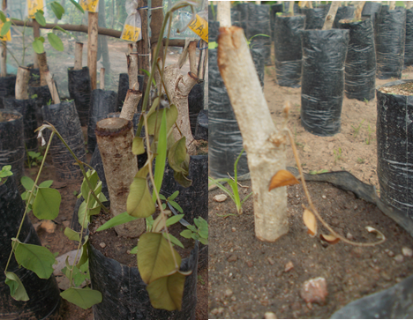
CONCLUSION AND PERSPECTIVES
Stem cuttings of Pterocarpus erinaceus propagate , not, the species naturally.

Slide 13
CONCLUSION AND PERSPECTIVES
Highest bursted, burd bursting rate (80%) ( Used AIA),
Stem of cuttings [2.6 – 3] (6.30 %) , 2000 mg/l of IAA (7.48%), 1 hour 8.70%, low rooting rate,
Used AIA, AIB, ANA , best rooting rate,
Used stem & root cuttings , best rate.

Slide 14
Thanks for your attention

Slide 15
SIRP-AO

